Slide 1


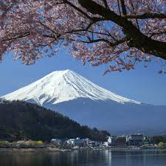
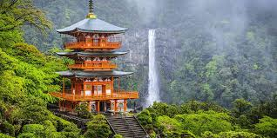
Hello champs my name is : Abdulrahman Mohamed And this is
My travel pack to JAPAN
13-16 December

Slide 2

Entry requirements
1.Passport Validity: Your passport should be valid for the entire duration of your stay.
2.Return Ticket: Some travelers may need to show proof of onward travel or a return ticket.
3.Accommodation Details: It is helpful to have a confirmed hotel booking or address where you’ll be staying.

Slide 3
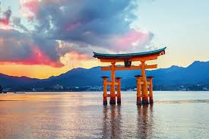

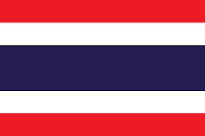






Countries that don’t need visa
90 Days Stay
30 Days Stay
30 Days Stay
Official websites
Tourism agency
Foreign affairs

Slide 4
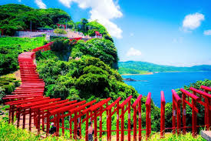
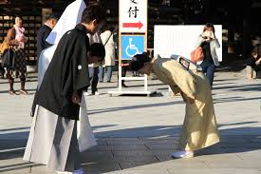



ETIQUETTE AND CULTURAL EXPECTATIONS

Slide 5
Greeting elderly people
Bowing to older Japanese people is considered polite and respectful, especially if they are much older.

Slide 6
Don’t raise your tone
In Japan, talking loudly in public places or on the streets is generally considered impolite. Japanese culture values harmony, respect for others, and maintaining a quiet and calm public atmosphere.

Slide 7
Gift Giving: Omiyage and Oseibo
Always present the gift with both hands, and it’s polite to say, "Tsumaranai mono desu ga" (This is just a small thing) as a humble gesture.

Slide 8
Exchange of Business Cards (Meishi Koukan)
The exchange of business cards, known as meishi koukan (名刺交換), is a significant part of Japanese business culture.

Slide 9
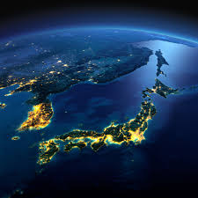
Top 3 places to visit in Japan
Mount Fuji
Tokyo
Kyoto

Slide 10
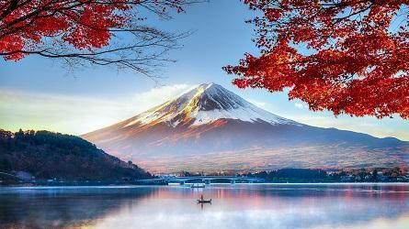
Mount Fuji
#1 in Best Places to Visit in Japan
The country's tallest mountain and one of its most iconic landmarks is a popular destination for outdoor recreation. For centuries, Japanese artists and poets have been inspired by Mount Fuji's almost perfectly round form. The Fuji Five Lakes region at the foot of this UNESCO World Heritage Site makes a great base for the thousands of climbers who visit each year. While you're here, spend some time enjoying the area's museums and amusement park, and in winter, take a relaxing soak in the onsen after skiing Mount Fuji's slopes.

Slide 11
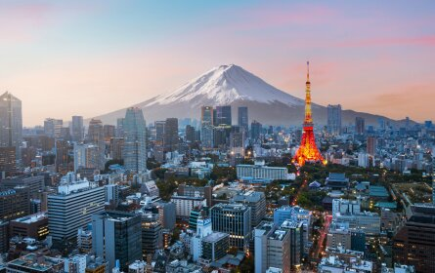
Tokyo
#2 in Best Places to Visit in Japan
This metropolis is a feast for the senses. Neighborhoods like Ginza and Akihabara buzz with flashing lights and larger-than-life shopping, while Meiji Jingu Shrine and the Tokyo Imperial Palace give you a look into Japan's storied past. There are also a number of green spaces like Shinjuku Gyoen National Garden, which acts as a place to escape from the chaotic concrete jungle. What's more, Tokyo is regularly regarded as a top foodie city thanks in part to its abundant Michelin-starred restaurants (the most you'll find in any city in the world), so come hungry

Slide 12
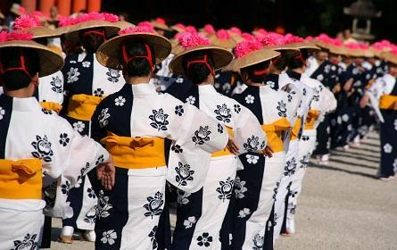
Kyoto
#3 in Best Places to Visit in Japan
Travelers most interested in Japan's history and traditions should head to Kyoto. Centrally located on the archipelago, Kyoto has long been considered the cultural capital of Japan. Here, you'll find more than 1,500 Buddhist temples and around 400 Shinto shrines (you can't miss the Kiyomizu-dera Temple and Fushimi Inari Taisha), including a whopping 17 UNESCO World Heritage sites. You can also stroll through geisha districts like Gion and Miyagawacho, admire classic wooden architecture and visit traditional teahouses before checking out more modern attractions, such as the Kyoto Aquarium

Slide 13

Travel budget
item | cost
Visa application process | $50
Flights | $900
Accommodation | $400
Activities | $100
Meals | $160
Total cost | $1,610

Slide 14
Travel Itinerary
Date | Time | Activity/Detail | Location
13th Oct | 12:00 PM | Flight from Cairo (CAI) to Tokyo (NRT) | Cairo International Airport
 | 5:30 AM | Arrive in Tokyo, Japan | Narita International Airport
 | 8:00 AM | Check-in at Shinjuku Granbell Hotel | Shinjuku, Tokyo
 | 1:00 PM | Lunch at Ichiran Ramen | Shinjuku
 | 6:00 PM | Explore Shibuya Crossing and dinner | Shibuya
14th Oct | 14th Oct | Visit Meiji Shrine | Shibuya
 | 12:30 PM | Lunch in Harajuku | Harajuku
 | 2:00 PM | Attend Tokyo Street Food Festival | Yoyogi Park
 | 7:00 PM | Dinner at Gonpachi Nishi-Azabu | Nishi-Azabu

